Slide 1

Getting started with R and R studio [CEoBS, University of brighton]
Dr. Biji Shibulal
Notes:
First of all, R is not scary like all Science researches describe it as; its simple but powerful progrmmng lang. and if I can do, you all can…
If you know how to enter keywords while googling stuffs, you can excel in R. As we are not developing a package or something we- as science researchers don’t need to write scripts from scratch. Every script you need is there in google. So google will be your best friend and there is web page called Stack overflow where the doubts/ errors you got might have been already asked by someone and the answers for it has been verified.

Slide 2


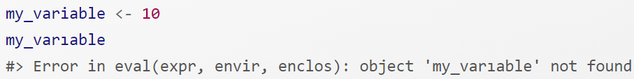
Look carefully! Training your brain to notice even the tiniest difference will pay off when programming.
Notes:
You might get frustrated in the beginning because it is such a stickler for punctuation, and even one character out of place will cause it to complain.
But you can get over it by keep trying

Slide 3

R is free and open source
Because R is a (statistical) programming language rather than a graphical interface, the user can easily save scripts as small text files for use in the future, or share them with collaborators.
**********************************************************
R itself does not have a graphical interface
We will be using a program called RStudio as a graphical front-end to R, so that we can access our scripts and data, find help, and preview plots and outputs all in one place.
Notes:
What is R? R is a progmng lang and we use R for pretty much everything from data anal to data visualiz. The major workflow to do R programming is loading your dataset to the R env. – This can be an excel file, tsv or csv file or even a fasta file. Then data wrangling which is tidying up and transforming ur data- if you have to change column/row name or if u want to merge two tables or if you subset your table-if you don’t want some columns/ rows not to be included in the analysis- these can be done during data wrangling and finally the data analysis and visualization. These 2 can interchange based on your analysis. For eg if you want to do some analysis such as linear regression you need to check whether your data is normally distributed- so you can visualize ur data as a histogram and check whether u get a parabolic curve and then proceed to analysis.
Why R and not other softwares or excel- I am not saying that you don’t have to use excel at all. I use excel a lot for preparing my database, entering my wetlab/field expt results etc. But I prefer R for data analysis and visualizatn.
You might have noticed that when we sent the instructions for downloading we provided two links- one for R and the other for R studio. SO what is the diff bet the two???

Slide 4
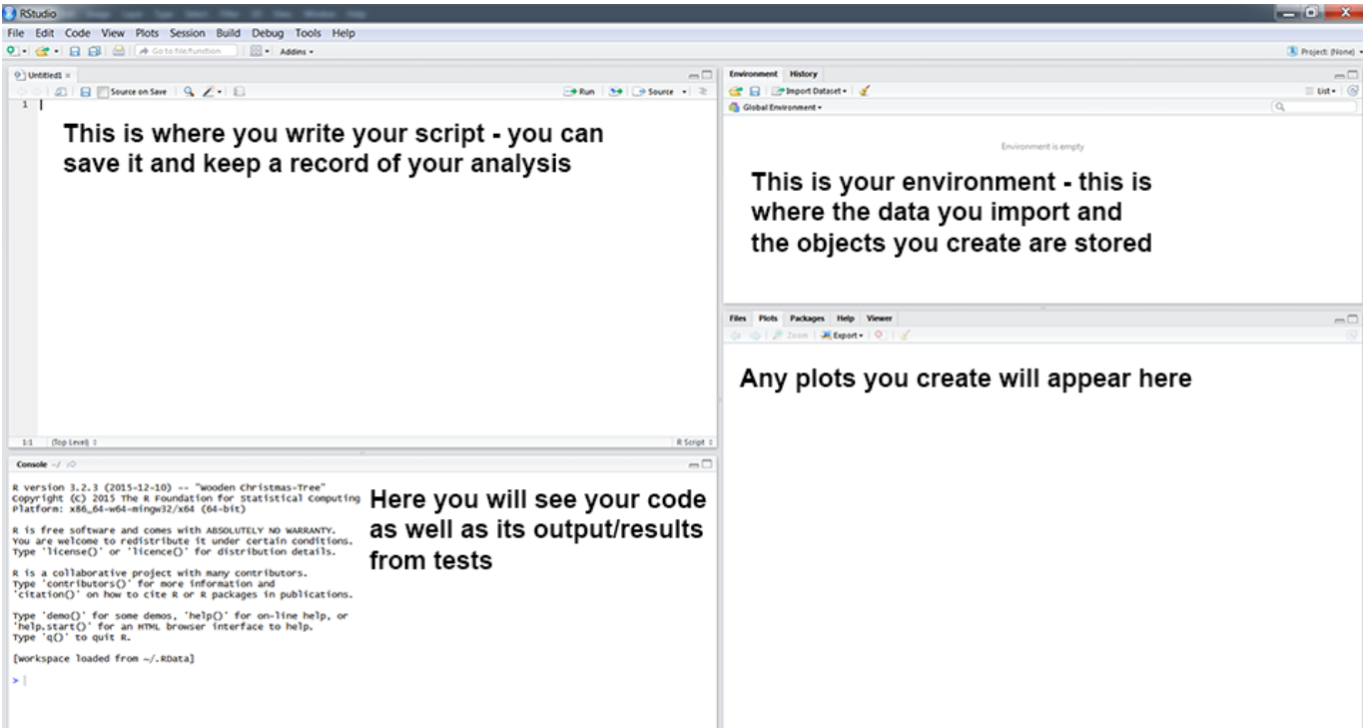

Slide 5


WHAT YOU HAVE TO DO
Type in these scripts at the script pane, evaluate what you typed, and to look at and think critically about the output.
You will make mistakes and generate errors!
In the process of fixing those errors, you’ll learn more about how R works, and how to avoid such errors, or correct bugs in your own code in the future.

Slide 6

REMEMBER to click Ctl+S very often
It’s useful to add comments to describe what you are doing by inserting a hasthag (#) in front of a line of text. R will see anything that begins with # as text instead of code, so it will not try to run it, but the text will provide valuable information about the code for whoever is reading your script (including future you!)
When you exit, R will ask you if you want to save the current workspace - NO (The workspace will have everything you have used in a session floating around your computer memory)

Slide 7

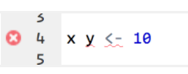
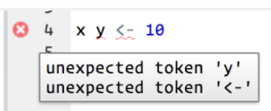
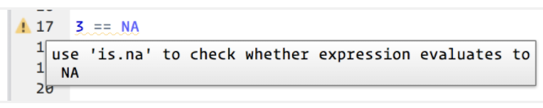
Running code
Cmd/Ctrl + Enter
RStudio diagnostics
The script editor will also highlight syntax errors with a red squiggly line and a cross in the sidebar:
Hover over the cross to see what the problem is:
RStudio will also let you know about potential problems:

Slide 8
Basic operators
== equals exactly
<, <= is smaller than, is smaller than or equal to
>, >= is bigger than, is bigger than or equal to
!= not equal to
%in% belongs to one of the following (usually followed by a vector of possible values)

Slide 9
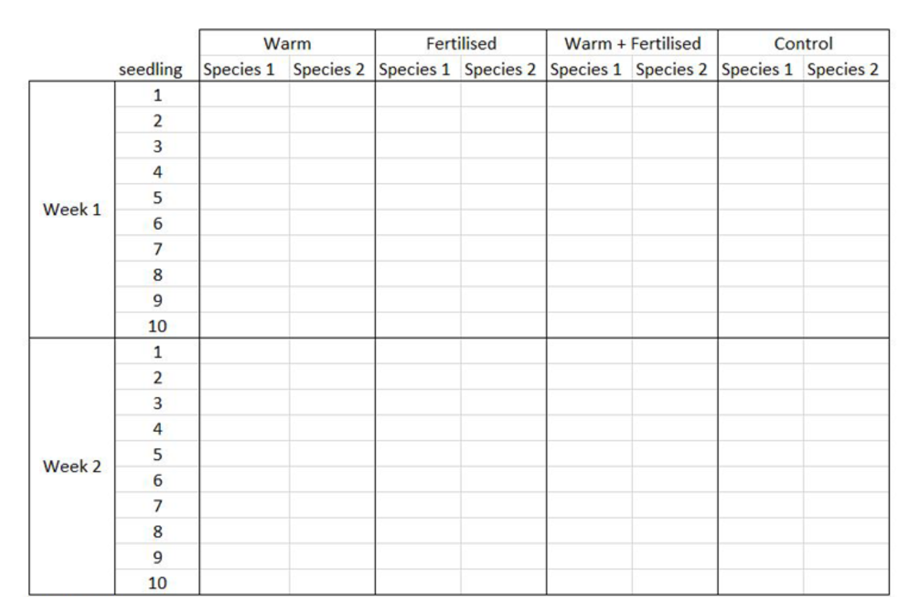
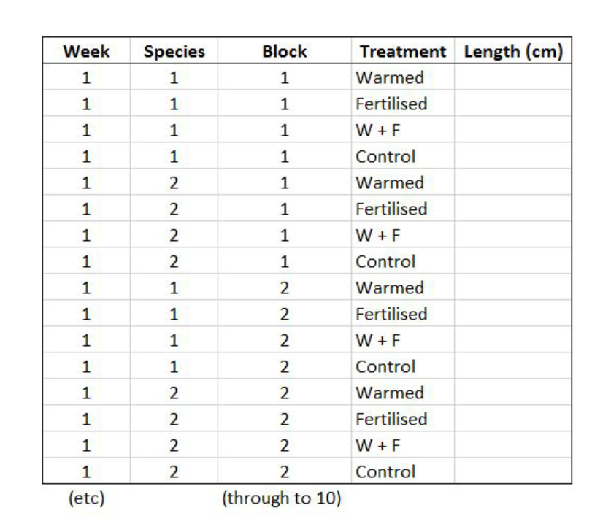
R needs the data to be in this format- row represents an observation and each column represents a variable
You might record your data like this in field/wet lab

Slide 10
Missing values in your dataset
The first obstacle in any data analysis - it’s important to master the methods to overcome them
In most statistical methods the default option is listwise deletion- leads to information loss
Some incredible R packages for missing values imputation.
5 R packages popularly known for missing value imputation
MICE
Amelia
missForest
Hmisc
mi

Slide 11
MICE
MICE = Multivariate Imputation via Chained Equations
Creates multiple imputations as compared to a single imputation (such as mean) - takes care of uncertainty in missing values.
MICE assumes that the missing data are Missing at Random (MAR), which means that the probability that a value is missing depends only on observed value and can be predicted using them. It imputes data on a variable by variable basis by specifying an imputation model per variable.
Contd…

Slide 12
MICE
By default, Predictive mean matching or linear regression is used to predict continuous missing values & logistic regression is used for categorical missing values
Once this cycle is complete, multiple datasets are generated.
These datasets differ only in imputed missing values. Generally, it’s considered to be a good practice to build models on these datasets separately and combining their results.
END OF DAY 1

Slide 13

GGPLOT
The GG in Ggplot = Grammar of Graphics
Scripting your code for plot is like constructing a sentence from different parts that logically follow each other, which means -
plotting workflow will therefore be something like creating an empty plot, adding a layer with your data points, then the axis labels, and so on.

Slide 14
GGPLOT
Decide on the right type of plot
A very key part of making any data visualisation is making sure that it is appropriate to your data type (e.g. discrete vs continuous), and fits your purpose, i.e. what you are trying to communicate!

Slide 15
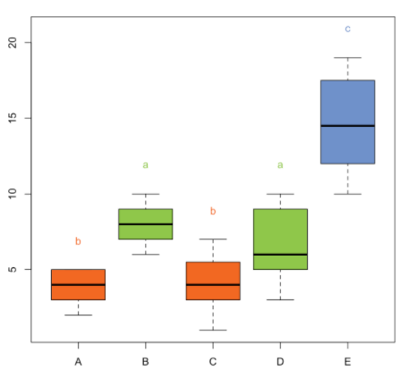
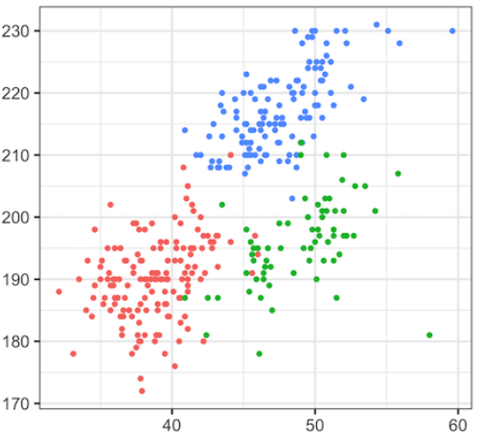
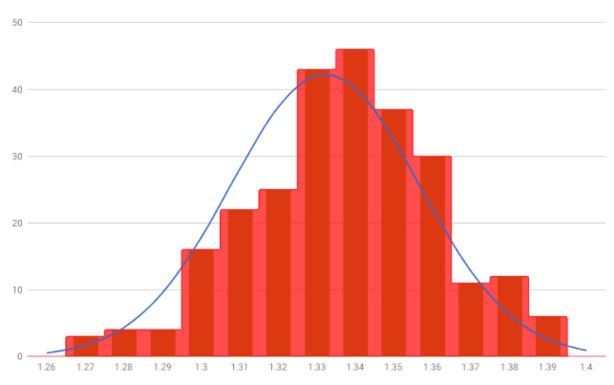
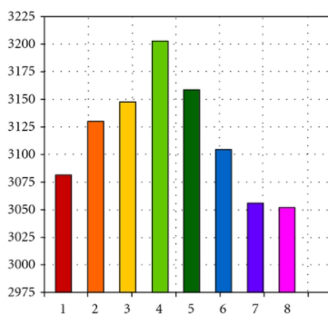
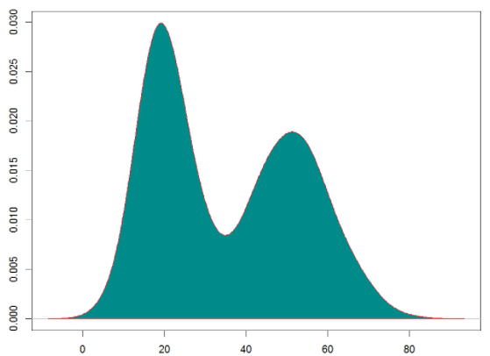
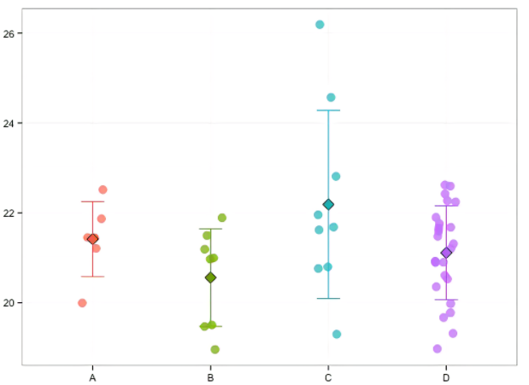
Show the distribution of your data
Compare values across groups
Show the relationship between variables
HISTOGRAM
BOXPLOT
BARPLOT
SCATTERPLOT
DENSITY PLOT
DOTPLOT

Slide 16
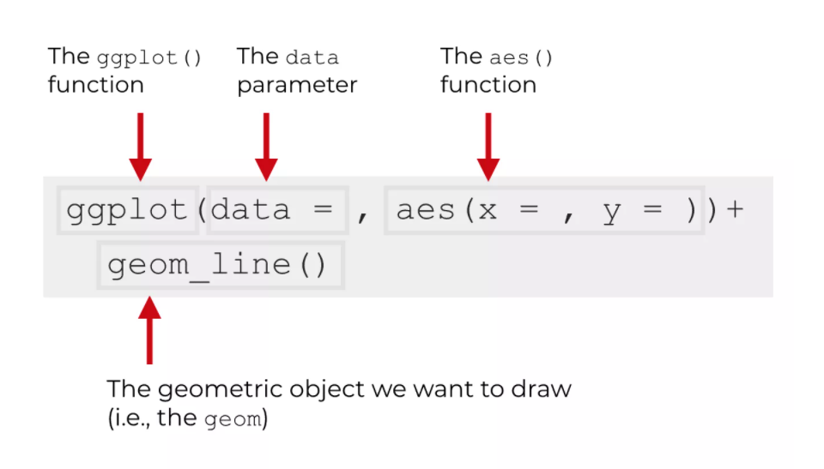
GGPLOT_basic syntax
Plot = data + Aesthetics + Geometry

Slide 17
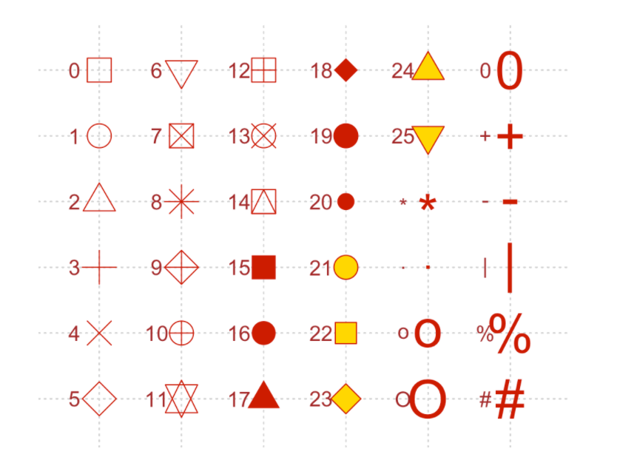
Different shapes available in R graphics

Slide 18
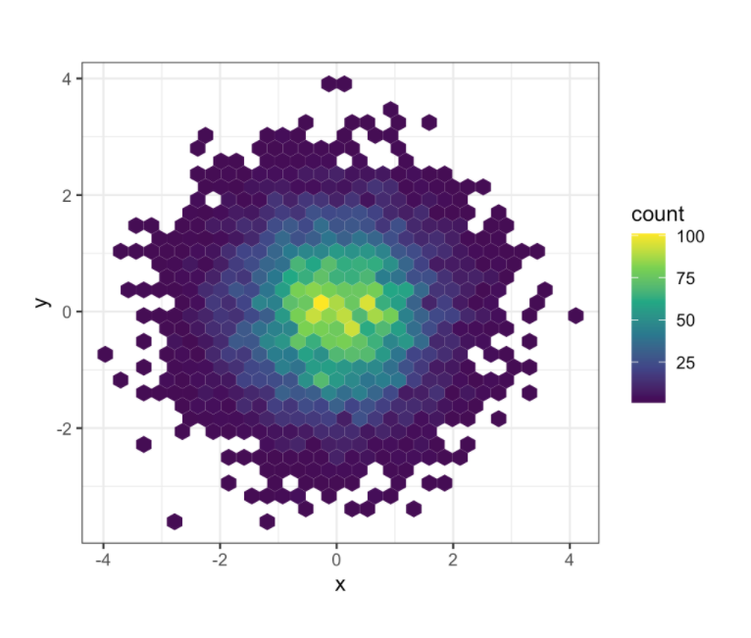
Viridis color palette

Slide 19
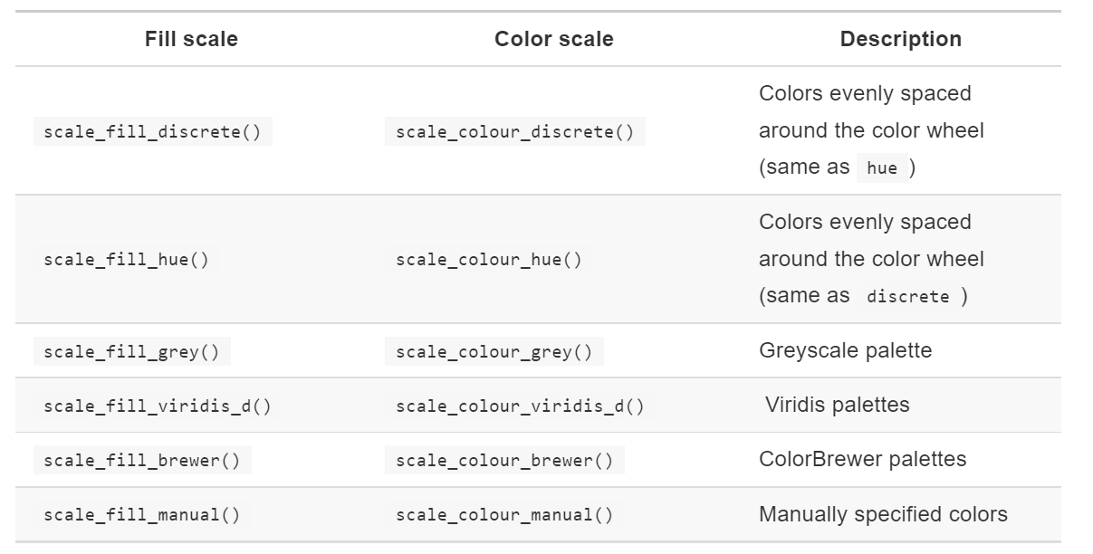
Discrete fill and color scales
Same result
plot + scale_fill_discrete()
plot + scale_fill_hue()
plot + scale_color_viridis()

Slide 20
Error in plot.new() : figure margins too large
Script to execute:
par(mar=c(1, 1, 1, 1))
This will adjust margin parameters automatically by R

Slide 21
t- test
to compare the means of two groups
One-sample t-test
Two sample/ Independent sample /unpaired t- test
The basic application is:
A/B Testing: Compare two variants
Case Control Studies: Before/after treatment
Paired/dependant/matched pairs t-test
For a t-test to produce valid results, the following assumptions should be met:
Random: A random sample or random experiment should be used to collect data for both samples.
Normal: The sampling distribution is normal or approximately normal.

Slide 22
Two sample t- test
The standard Student’s t-test
assumes that the variance of the two groups are equal
The Welch’s t-test
less restrictive compared to the original Student’s test
do not assume that the variance is the same in the two groups, which results in the fractional degrees of freedom

Slide 23
t.test()
One Sample t-test
data: mice$weight
t = -8.1045, df = 9, p-value = 1.995e-05
alternative hypothesis: true mean is not equal to 25
95 percent confidence interval:
18.78346 21.49654
sample estimates:
mean of x
20.14
Degree of freedom= n-1
p-value<0.05; reject H0
The true mean is bet. This interval with a probability of 95%
Mean of the variable, Weight

Slide 24
stat.test()
stat.test
# A tibble: 1 x 7
.y. group1 group2 n statistic df p
* <chr> <chr> <chr> <int> <dbl> <dbl> <dbl>
1 weight 1 null model 10 -8.10 9 0.00002
The outcome variable
The compared groups in the pairwise tests. Here, we have null model (one-sample test).
The t-test value
dbl stands for double class. A double-precision floating point number. It is a data type defined to hold numeric values with decimal points

Slide 25
Cohen’s d test
Recall that, t-test conventional effect sizes, proposed by Cohen J. (1998), are:
0.2 (small effect),
0.5 (moderate effect) and
0.8 (large effect) (Cohen 1998).
As the effect size, d, is 2.56 you can conclude that there is a large effect.

Slide 26
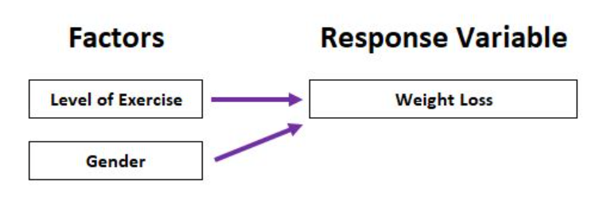
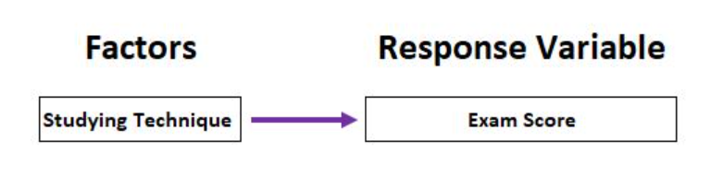
ANOVA (analysis of variance)
centred on the different sources of variation in a typical variable
to determine whether or not there is a statistically significant difference between the means of three or more groups.
Normality
Equal variance
Independence- randomized design
One-way ANOVA
Two-way ANOVA

Slide 27
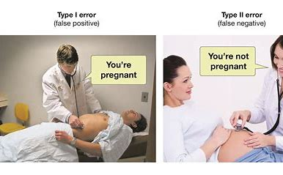
t-test is type I error prone

Slide 28
3 groups; A B C = t-tests to be done are A-B, B-C, A-C
The probability that we commit a type I error with one t-test is 1 – 0.95 = 0.05.
The probability that we commit a type I error with three t-tests is 1 – (0.95³) = 0.1427.
An ANOVA controls for these errors so that the Type I error remains at just 5%. This allows us to be more confident that a statistically significant test result is actually meaningful and not just a result that we got from performing a lot of tests.
When we want to understand whether there is a difference between the means of three or more groups, we must use an ANOVA so that our results are statistically valid and reliable.

Slide 29
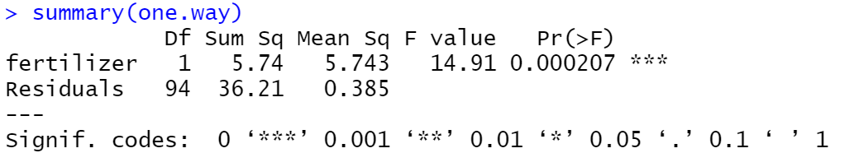
The test statistics = the mean square of each independent variable divided by the mean square of the residuals. The larger the F value, the more likely it is that the variation associated with the independent variable is real and not due to chance.
The total variation = SUM SQ. between the group means and the overall mean explained by that variable. The sum of squares for the fertilizer variable is 5.74, while the sum of squares of the residuals is 36.21.
The mean of the sum of squares, calculated by dividing the sum of squares by the degrees of freedom.
P- value
Model error

Slide 30
Linear regression
A statistical model that analyzes the relationship between a response variable (often called y) and one or more variables and their interactions (often called x or explanatory variables).
Check that our data meet the four main assumptions of linear regression
Independence of observations (or no autocorrelation)
Normality
Linearity
Homoscedasticity

Slide 31
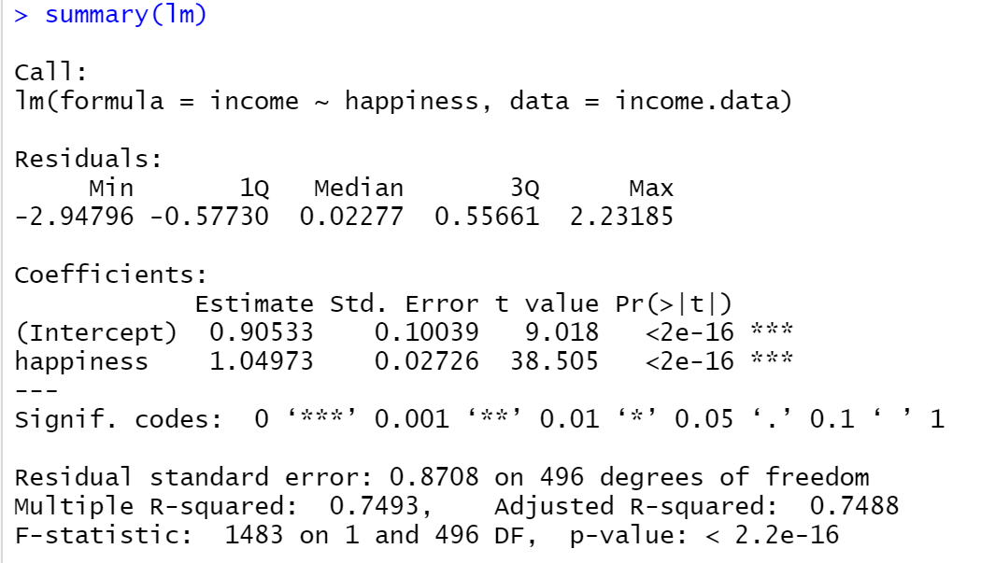
estimated effect of income on happiness
P-value

Slide 32
CORRELATION ANALYSIS
Test the assumptions:
Linearity: Visible from the plot itself
Normality: Using Shapiro test
If the data are not normally distributed, it’s recommended to use the non-parametric correlation, including Spearman and Kendall rank-based correlation tests.

Slide 33
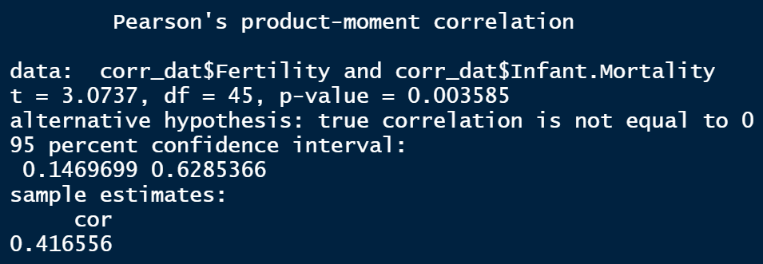

Slide 34


